Slide 1
Campus administration
Navruza Tulkunova
Aleksey Yakovlev
Roman Tokarev
Mo Haoran

Slide 2
Idea of the Project
Developing an application for managing all tasks related with the allocation and monitoring of the students’ housing facilities.
It will make the dormitory administrator work easier, more efficient, and make fewer mistakes

Slide 3
Main features
Apartments’ occupation control
Guest control
Students and personnel documents maintenance
Payment control
Personnel attendance control
Access control

Slide 4
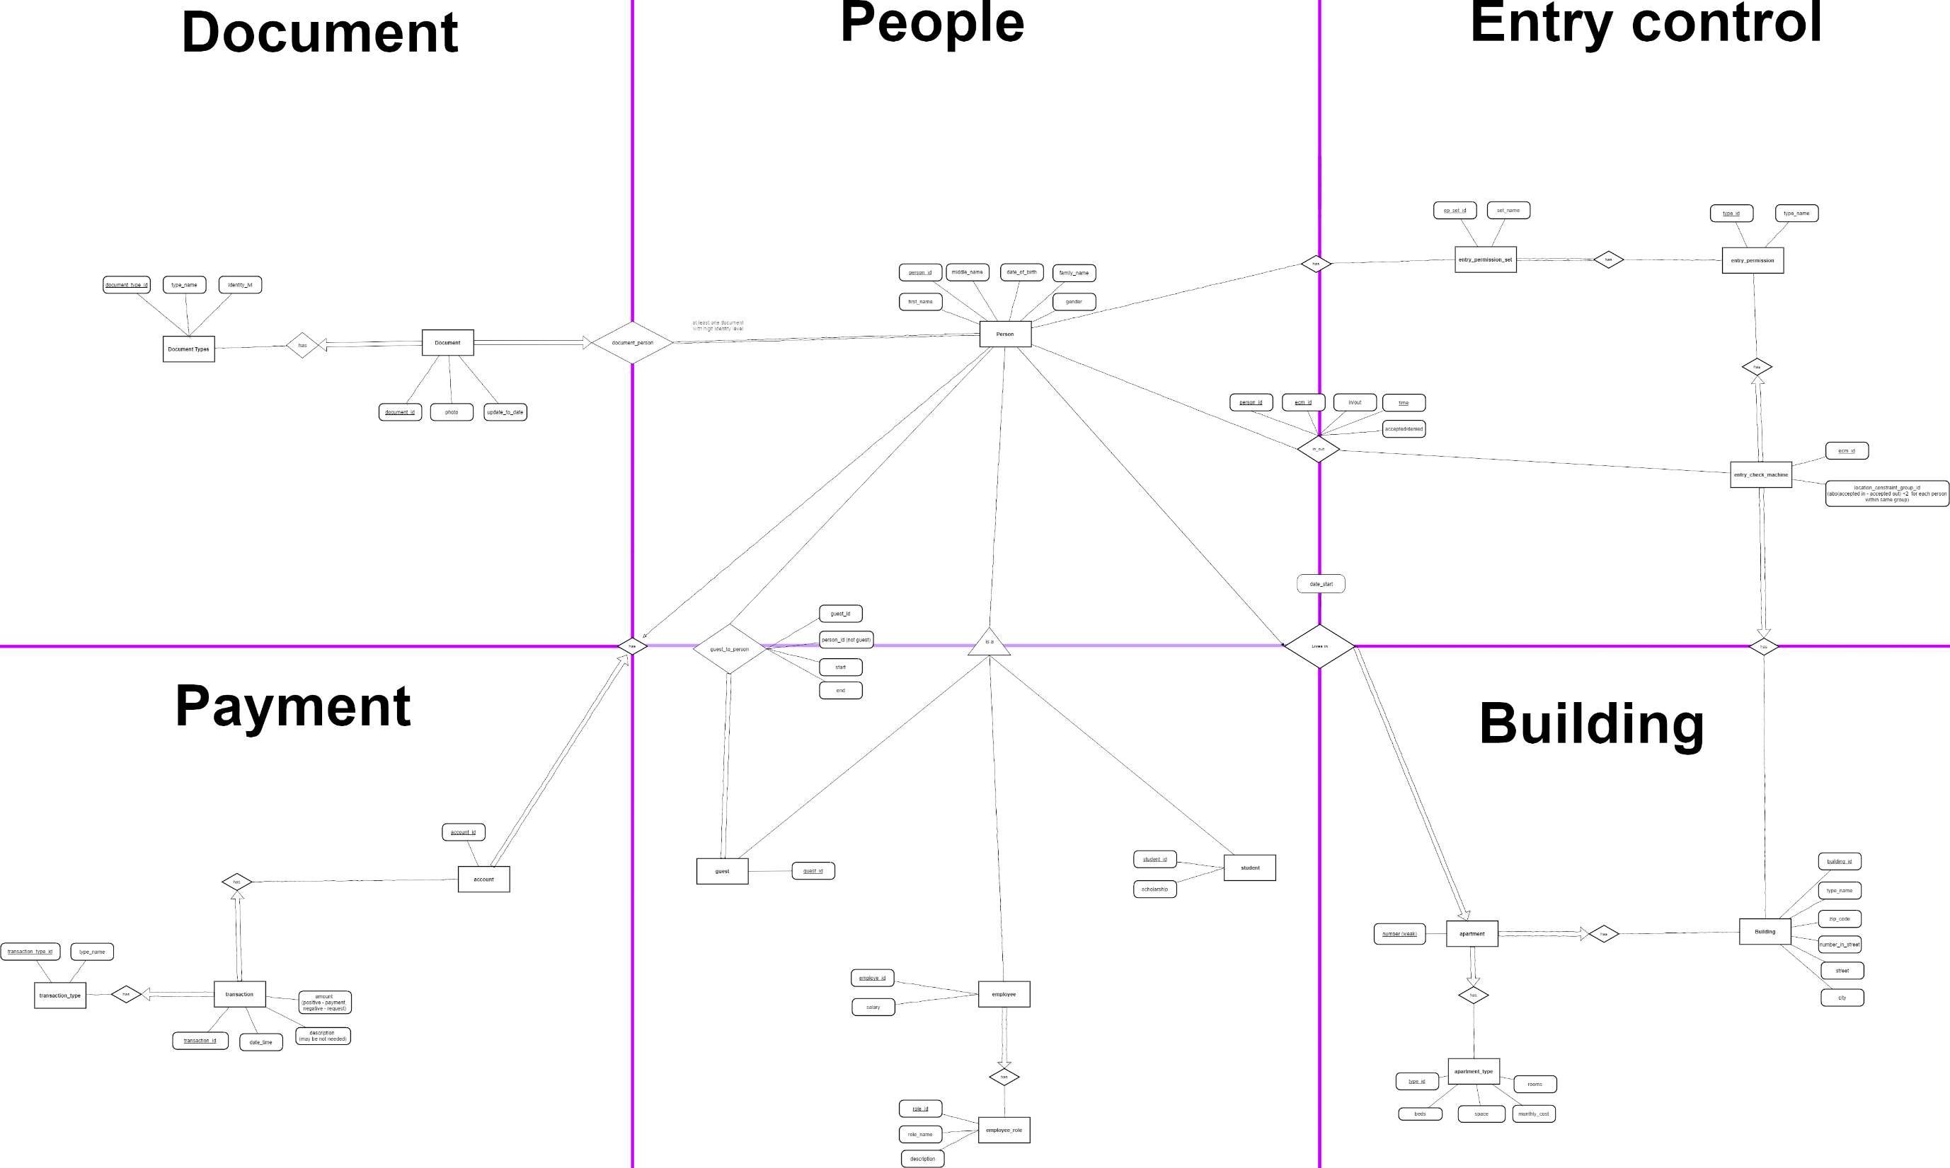

Slide 5



Technologies

Slide 6
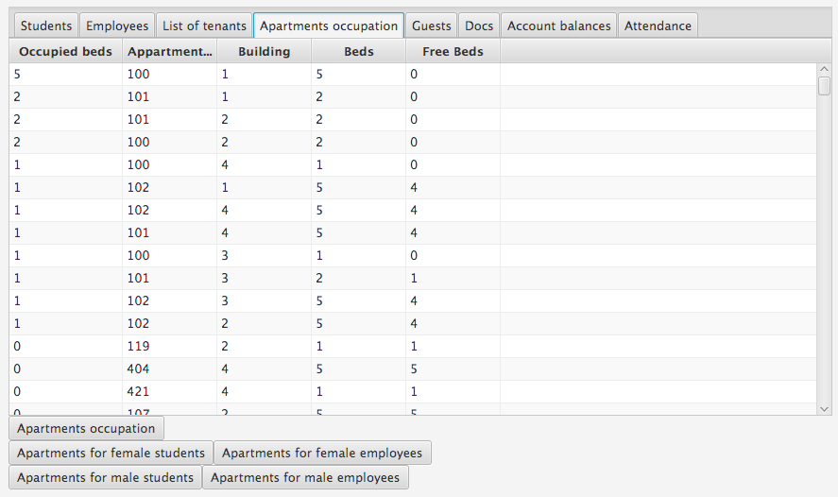
SELECT * FROM apartment_occupation ORDER BY beds_occupied DESC

Slide 7
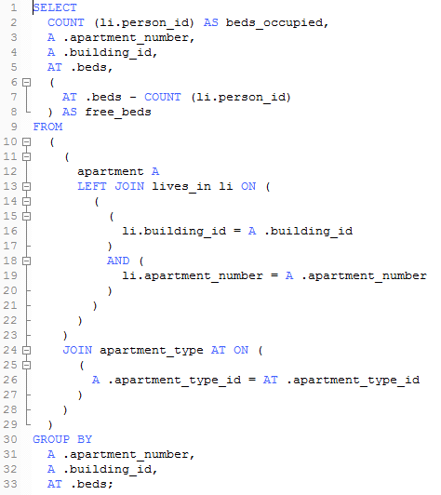

Slide 8
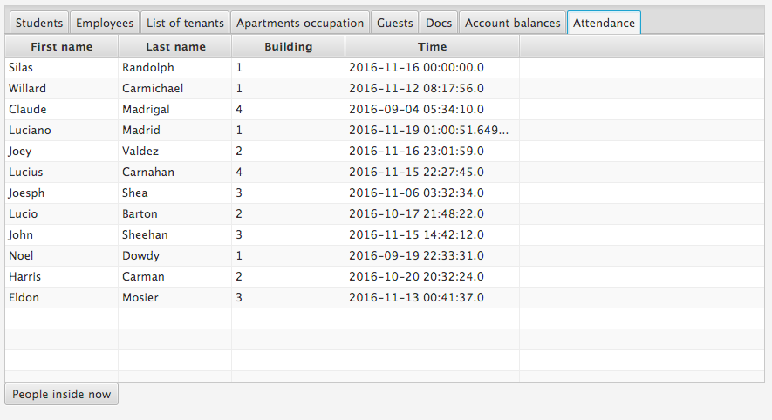
SELECT first_name, family_name, building_id, date_time FROM persons_inside_campus_now

Slide 9
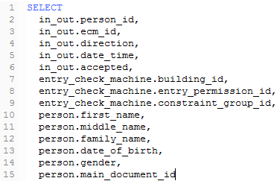
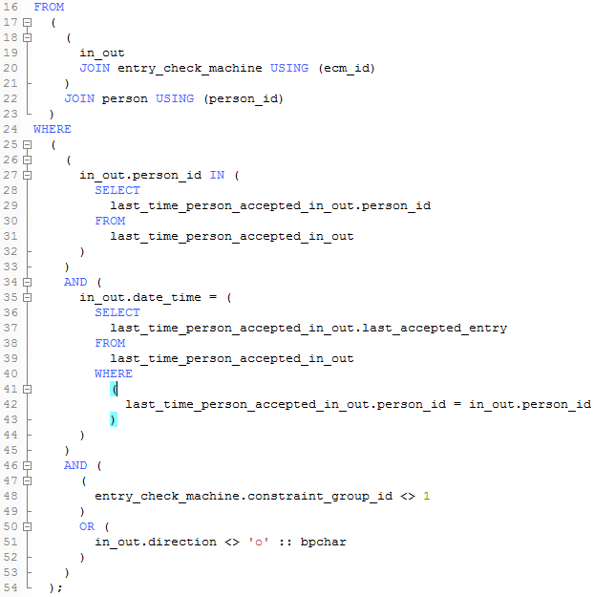
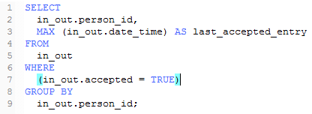

Slide 10
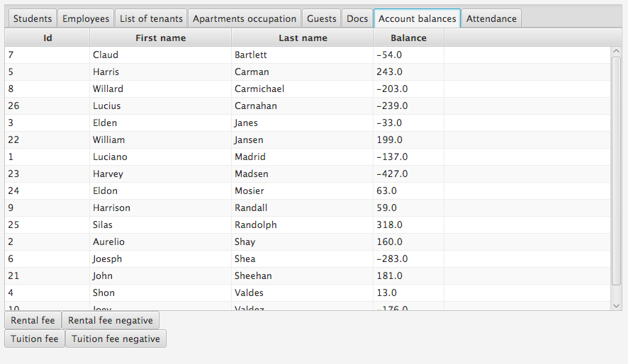
SELECT * FROM rental_fee_balance ORDER BY family_name

Slide 11
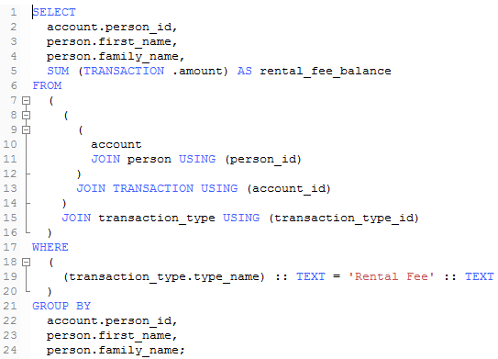


Slide 12
Demonstration of the application

